Slide 1
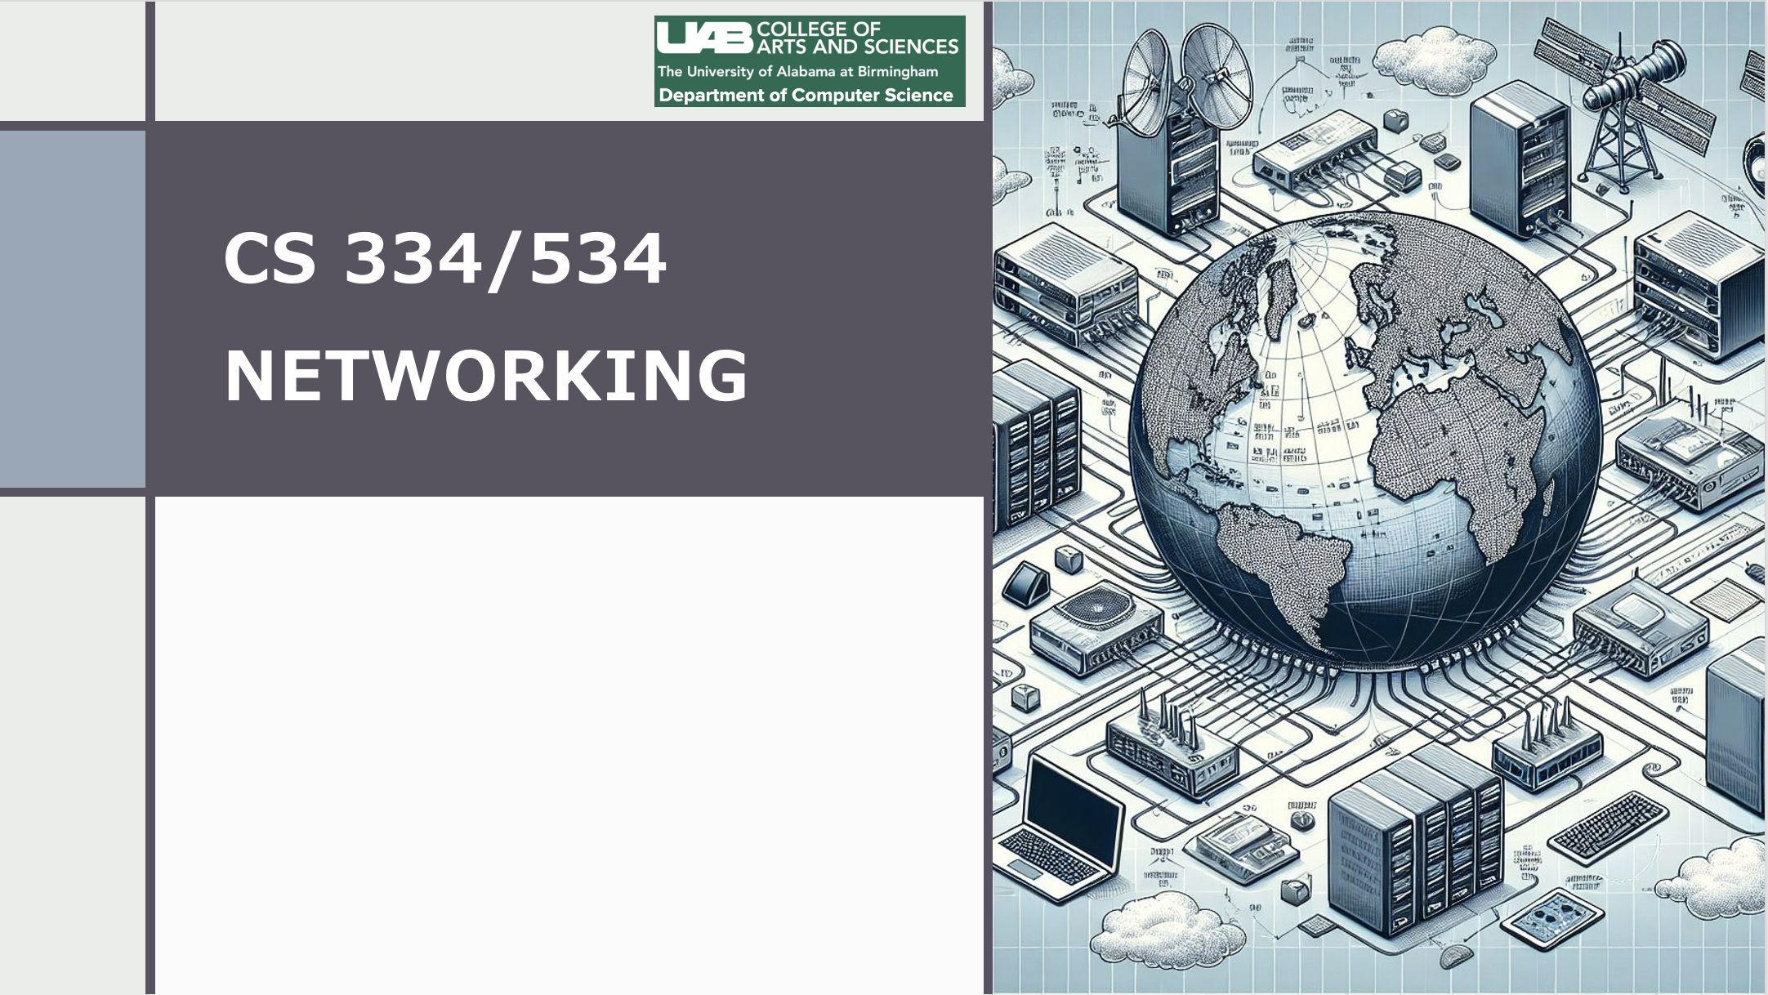
Dr. Ragib Hasan
Lecture 5.1:
The Internet Protocol (IP)

Slide 2
The Big Picture …
So far, we looked at the Link Layer or LAN Layer, which deals with how computers can connect to each other locally.
But how do we reach computers in other networks, which may not be directly connected to our network?
Network Layer -- the next layer in the TCP/IP model provides an answer!

Slide 3
LAN layers show how to move data locally
For global communications, LAN protocols aren’t enough
We need 3 tasks to be handled globally
  Standard Packet Format: We need to decide on a common format for packets or datagrams
  Global Addressing Scheme: We need an addressing scheme
  Path forwarding scheme: We need a way to figure out where to send the packet next
In today’s networks, IP is the dominant technology in the network layer

Slide 4
“The Internet is the IP protocol”

Slide 5

Internet Protocol (IP)
The Internet Protocol (IP) is a fundamental protocol that allows computers to communicate with each other over the internet or within isolated networks.
IP is independent of upper and lower level protocols – even if you have a different transport and different Link layer (LAN) protocol, the Internet still works!
Analogy: The Postal System! Doesn’t matter what you are sending in the envelop – as long as it fits the envelop, and contains the correct address, the postal system will route it to the ultimate destination.

Slide 6
IP is ubiquitous
On the Internet, (almost) every network is running using IP as the network layer protocol
IPV4 was originally designed in 1981, and is still used by the majority of the Internet systems.
A newer version, IPV6, is gradually being adopted.
IP became successful because it is highly scalable – even with billion hosts on the Internet, routing is still efficient and practical.

Slide 7
What does IP do?
It defines the packet structure and format
IP defines the universal network address scheme
IP provides a method for routing packets

Slide 8
Key design principles in IP
Make it “best effort” – routers make the best effort to deliver packets but don’t guarantee it. (Why?)
Maintain no state (why?)
Don’t even try to acknowledge successful delivery of packets (why?)

Slide 9
IP Packet format
Packets in IP have a header (for packet information) and packet content or payload.
The IPv4 Header contain the following information:
destination and source addresses
indication of ipv4 versus ipv6
a Time To Live (TTL) value, to prevent infinite routing loops
a field indicating what comes next in the packet (eg TCP v UDP)
fields supporting fragmentation and reassembly.

Slide 10
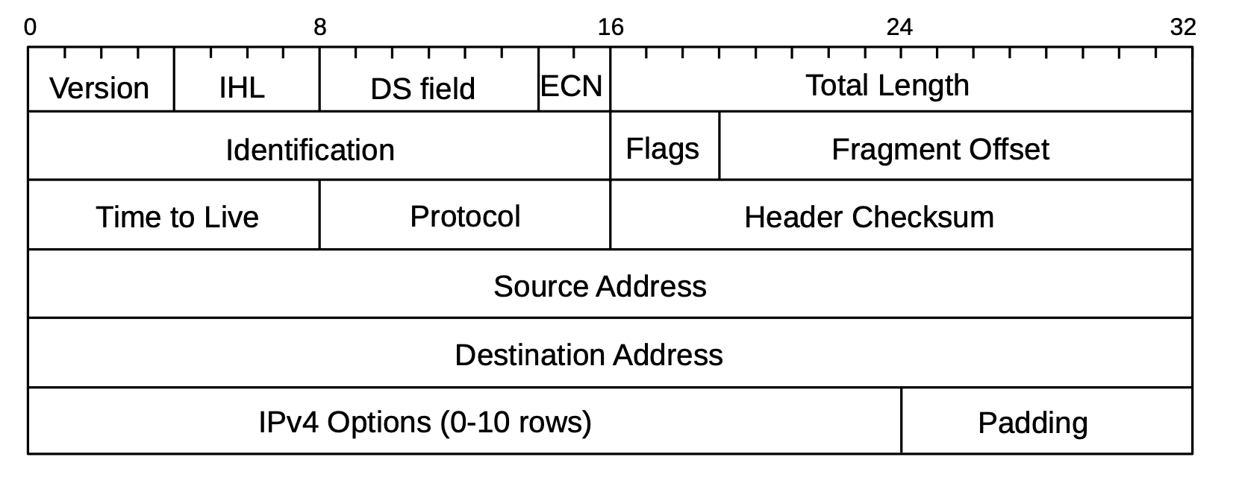
IP Header

Slide 11
IP Header fields and their meanings
Version: The version number. (IPv4 = 0100).
IHL: the total IPv4 Header Length, in 32-bit words; (What would be the maximum length of an IPv4 header?)
The Differentiated Services (DS): To specify preferential handling for designated packets, eg those involved in VoIP or other real-time protocols.
ECN: Explicit Congestion Notification bits are there to allow routers experiencing congestion to mark packets (Why?).

Slide 12
IP Header fields and their meanings
Total Length: Length of the IP packet in total. What’s the maximum length?
ID/flags/fragmentation offset – used to handle packet fragmentation
Time to live (TTL): decreased at each hop. Packet is dropped when TTL reaches 0. (Why?)
Protocol: What is content of the IP packet? What protocol?
Checksum: To validate integrity of the header
Source/destination: IP address of the source and destination

Slide 13
Can you spoof the source address?
Yes! You can essentially put any source address in the IP header.
The local router won’t check if you put the correct IP
Side effect: A distributed denial of service attack named the Smurf Attack!
  Attacker sends out an ICMP echo packet (e.g., a ping request)
  The packet has a spoofed IP address as source – the attacker puts the victim’s IP address as source
  This fake ping is sent to many servers on the web
  The ping responses go to the victim from all these different servers at the same time, essentially crashing it!

